Slide 1

PSYC401: Analysing and Interpreting Psychological Data I
Padraic Monaghan
Room C5, Fylde College
p.monaghan@lancaster.ac.uk

Slide 2
Module outline
Week 1: Introducing data, introducing Rstudio
Week 2: Manipulating data, using Rstudio
Week 3: Exploring data and creating figures and graphs, using Rstudio
Week 4: Categorical data and the chi-squared test – testing random versus structured?
Week 5: t-tests – testing whether two groups are different
Week 6: Research report/analysis
Week 7: Measurement, hypotheses, associations (correlations)
Week 8: Predicting behaviour: the linear model
Week 9: Data visualisation
Week 10: Predicting behaviour: developing the linear model

Slide 3
Objectives for Week 4
By the end of this session, you should be able to:
Understand the value of conducting statistical tests and interpreting p-values
Understand null effects and null hypotheses
Understand the difference between parametric and non-parametric data
Understand when to apply the Chi-squared test
Understand the relation between Cramer’s V test and the Chi-squared test
Be able to apply the Chi-squared test to data and interpret the result
Be able to apply Cramer’s V test to data

Slide 4
The point of a statistical test
To tell us whether there is a pattern in our data
A test gives us two things: the size of the effect, and a p-value, which tells us about the significance
If a test is significant, then it tells us there is a pattern, or some structure in our data
If a test is not significant, then this could be for two reasons
There is no pattern in the data
There is a pattern but we can’t find it through the noise
A statistical test cannot decide between these alternatives

Slide 5
Reminder: Reproducibility – variation and reliability
Results will not replicate perfectly, because responses contain noise
observed scores are a combination of true score and error
If the error is random then
some people will accidentally score more, and some less, than their true score
true differences between participants’ scores will be unrelated to error differences
So the total variance of observed scores, for a sample of participants, will equal the variance of their true scores plus the variance of their error scores sd_{obs}² = sd_{true}² + sd_{err}²

Slide 6
Effect sizes and p-values
When we construct an experiment, we construct a research hypothesis:
Two variables are related
An experimental manipulation will affect another variable
We also construct a null hypothesis:
Two variables are not related
The experimental manipulation has no effect
p-value: how confident can we be in rejecting the null hypothesis
A p-value of 0.05 tells us that 5% of the time when we find an effect like this, the null hypothesis is true (a false positive)
If the p-value is less than 0.001, we write by convention: p < .001
If there’s a chance less than one in a thousand that we find this effect when the null hypothesis is true then we’re quite confident in our result

Slide 7
Reminder: Types of Data
Numbers have three important functions for researchers:
Classify or categorise - Nominal data
E.g. male/female, young/old, red/green/blue
Each case can only be in one category.
Rank or order - Ordinal data
E.g. first, second, third…
Does not indicate magnitude of differences between ranks.
Score – Interval/Ratio data
E.g. number of correct answers, reaction time
Tells us about the order of data but also the distance between them.

Slide 8
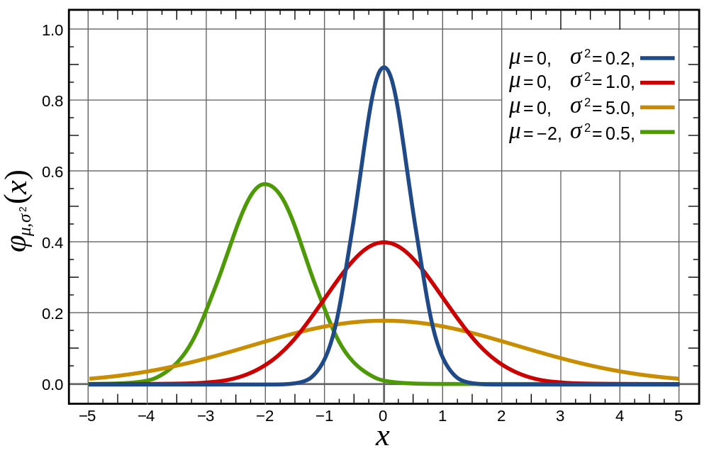
Reminder: Normal distribution
We assume (or test) that the actual data comes from a “normal distribution” of data
The shape of the normal distribution depends on two factors:
Mean (μ) – Measure of central tendency
Standard Deviation (σ) – Measure of variability

Slide 9
Parametric and non-parametric
If data fit a normal distribution, then we can use “parametric” statistical tests
If data do not fit a normal distribution, then we need to use “non-parametric” statistical tests
Categorical data are non-parametric
One non-parametric test is Chi-squared, which is useful for determining if categorisations into two or more groups are different than chance

Slide 10
Summary
Why do a statistical test?
Random or structured
A statistical test gives a p-value
Chance of an observed effect being due to chance
Parametric and non-parametric tests
Data approximates a normal distribution … or not

Slide 11
Summary
Chi-squared test is a measure of association between categories/nominal groups
Interpretation of Chi-squared and p-values
Expected and observed frequencies
Cramer’s V effect size measure of association
How to report Chi-squared test results and Cramer’s V effect size

